Slide 1
EECS E6895 - Final Project A-share Stock AI Trader
B9: Investment Strategy - AI Trader (CN/HK/TW/JP)
Yiwen Fang (yf2560) | Guoshiwen Han (gh2567)

Slide 2
Introduction
System Overview
Data
Methods
Experiments
Web Application Demo
Challenges
Achievements
Conclusions
Timeline
References
Q & A

Slide 3
Introduction
The financial market is one of the first to adopt machine learning. Since the 1980s, people have been using ML to discover the laws of the financial market. Although ML has achieved great success in forecasting in other fields, the stock market is a market where everyone can invest in profit, but ML forecasts have not achieved significant results.
As stock traders, we want to simulate stock prices or its trend correctly so that we can reasonably decide when to buy stocks and when to sell stocks in order to achieve maximum profitability.
The stock price itself is difficult to predict due to many factors, which means that it is difficult for you to find a model that can perfectly predict the stock price. I am not alone in thinking so. Princeton University economics professor Burton Malkiel wrote in his book “A Random Walk Down Wall Street” published in 1973: “If the stock market is efficient enough that people can know all the factors that affect it from public stock prices, Then everyone can speculate in stocks like investment professionals.”

Slide 4
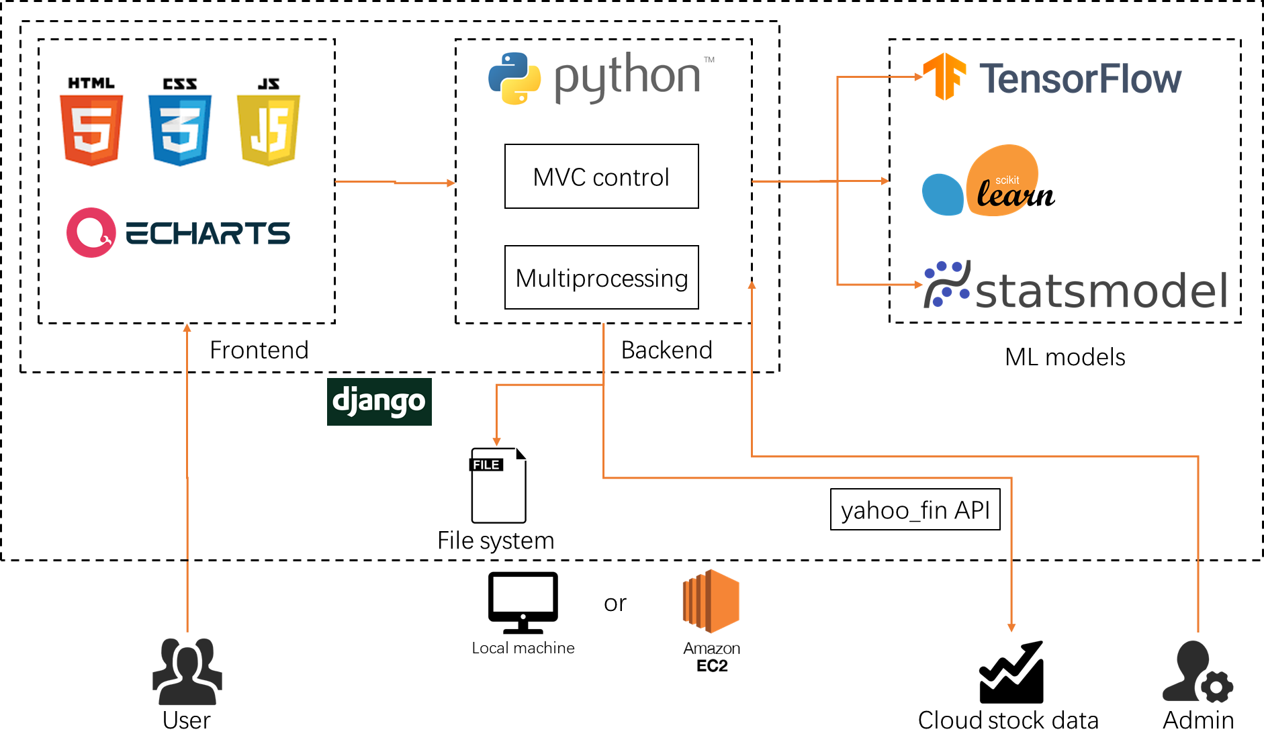
System Overview

Slide 5
Data Data pipeline
Data source
Daily Open-High-Low-Close (OHLC) time series price data of A-share main board stock in Shanghai/Shenzhen Stock Exchange
Data volume
2000+ stocks, each stock has daily data points lasting since IPO
Data extraction
yahoo_fin for Yahoo Finance
Data filtering
Drop NULL for non-trading days
Data pre-processing
LSTM: Using the absolute values of the prices
SVM: Using the relations instead of absolute values
ARIMA: Resampling and difference

Slide 6
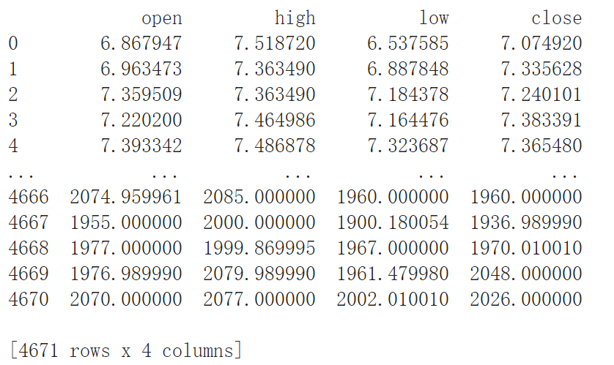
Data Processed by LSTM: Using the absolute values of the prices
# Training Set # time_step: time step，batch_size: how many examples are trained in each batch def get_train_data(batch_size=60, time_step=20, train_begin=0, train_end=train_end_index): batch_index = [] data_train = data[train_begin:train_end] normalized_train_data = (data_train - np.mean(data_train, axis=0)) / np.std( data_train, axis=0) normalized_train_data = normalized_train_data.values train_x, train_y = [], [] # training set for i in range(len(normalized_train_data) - time_step): if i % batch_size == 0: # start batch_index.append(i) # Get time_step rows data at one time # x stores the input dimension (not including label, the last one is not taken) # Standardization (normalization) x = normalized_train_data[i:i + time_step, :n1] # y store label y = normalized_train_data[i:i + time_step, n1, np.newaxis] # np.newaxis is to increase the dimension in the row or column respectively train_x.append(x.tolist()) train_y.append(y.tolist()) # end

Slide 7
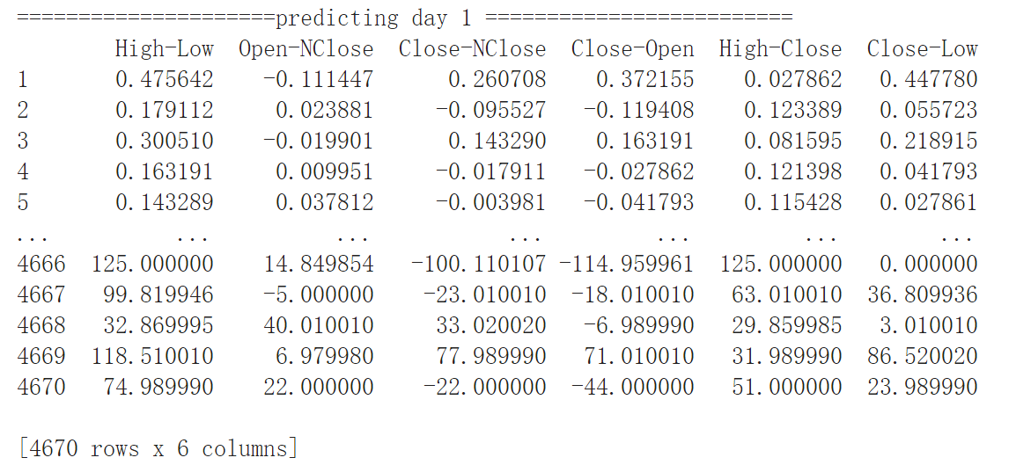
Data Processed by SVM: Using the relations instead of absolute values
value = pd.Series(Data['close'].shift(-n) - Data['close'], index=Data.index) # after n days, rise or fall Data['High-Low'] = Data['high'] - Data['low'] # Difference between High and Low Data['Open-NClose'] = Data['open'] - Data['close'].shift( n) # today's open - close of n days before Data['Close-NClose'] = Data['close'] - Data['close'].shift( n) # Today is rise or fall comparing with n days before Data['Close-Open'] = Data['close'] - Data['open'] # today's Close - Open Data['High-Close'] = Data['high'] - Data['close'] # today's High - Close Data['Close-Low'] = Data['close'] - Data['low'] # today's Close - Low value[value > 0] = 1 # 1 means rise value[value == 0] = 0 # 0 means it doesn't rise or fall value[value < 0] = -1 # -1 means fall Data = Data.dropna(how='any') del (Data['open']) del (Data['close']) del (Data['high']) del (Data['low']) print(Data) # print(type(Data)) Data['Value'] = value

Slide 8
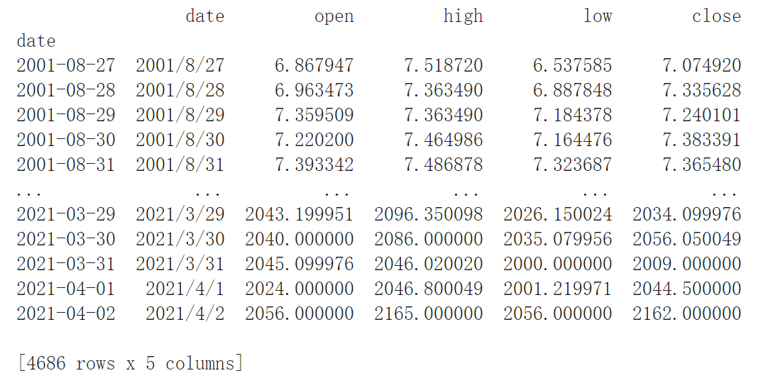
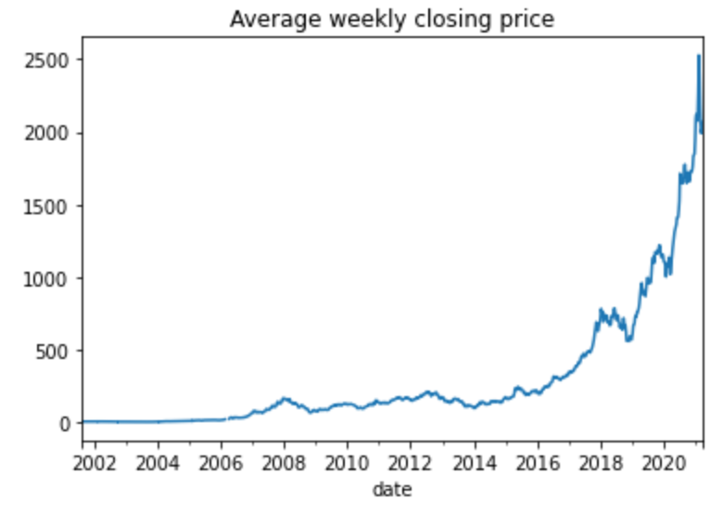
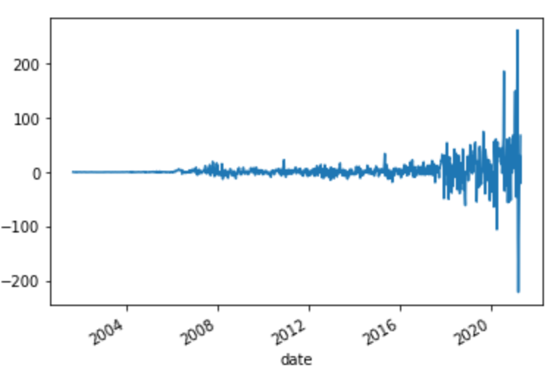
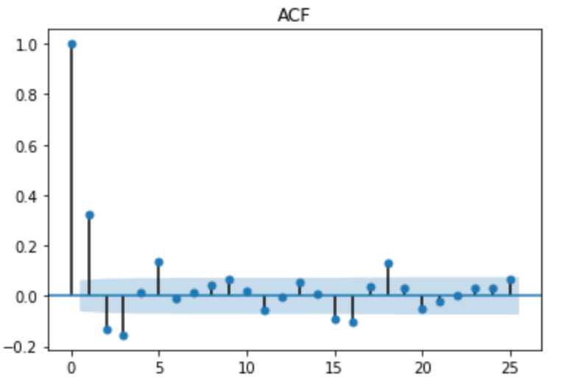
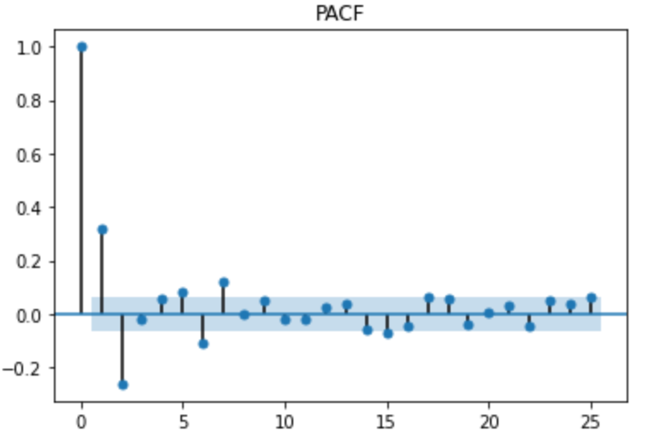
Data Processed by ARIMA: Resampling and difference
# Resampling to determine weekly average stock_week = StockDate['close'].resample('W-MON').mean() # First difference diff_data = train_data.diff(1).dropna() diff_data.plot() plt.show() # Check acf and pacf to determine q and p in training acf = plot_acf(diff_data, lags=25) plt.title('ACF') acf.show() pacf = plot_pacf(diff_data, lags=25) plt.title('PACF') pacf.show() plt.show()

Slide 9
Methods Three methods to train models for predicting, integrated by voting
LSTM
SVM
ARIMA
LSTM prediction
SVM prediction
ARIMA prediction
Vote
Vote
Vote
Integrated prediction

Slide 10
LSTM
Long and short-term memory network models are very powerful time series-based models that can predict any step backwards. An LSTM module (or an LSTM unit) uses 5 important parameters to model long-term and short-term data.
Unit state (𝑐_{𝑡})
This represents the short-term and long-term memory of the unit storage;
This is the output state information calculated based on the current input, the previous hidden state, and the current unit input for predicting future stock prices . In addition, the hidden state also determines whether to use only the memory in the unit state (short-term, long-term or both) for the next prediction;
Information flowing from the input gate to the unit state;
Information that flows from the current input and the previous unit state to the current unit state;
Information that flows from the current unit state to the hidden state, which determines the type of memory that LSTM uses next.
Hidden state (ℎ_{𝑡})
Input gate(𝑖_{𝑡})
Forgotten gate(𝑓_{𝑡})
Output gate(𝑜_{𝑡})

Slide 11
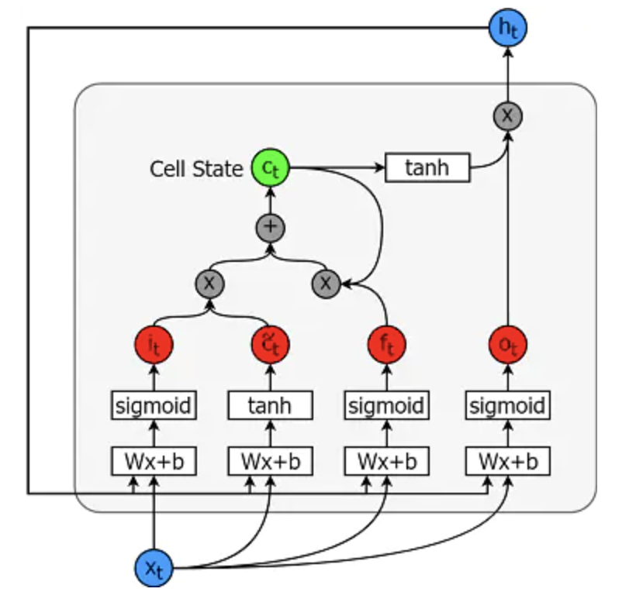
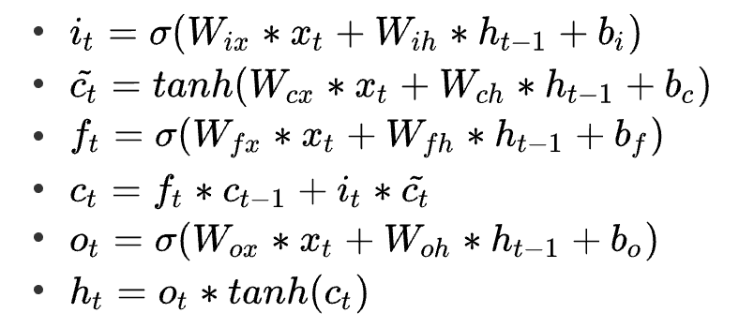
LSTM
Source: https://blog.nowcoder.net/n/9e75cb640cb24582b6f492fb7d895d99

Slide 12
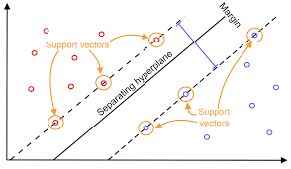
SVM
The so-called support vectors are these data vectors that affect the hyperplane in the high-dimensional space. These data points are actually the points located on the "black solid line", or the closest point to the dividing line;
Under strong duality, the solution of the dual problem is the solution of the original problem, and the dual problem is always a Concave optimization problem, so the SVM solution must be a globally unique solution and will not fall into a local minimum;
Hyperplane is a linear combination of data points;
SVM has a natural anti-overfitting ability to remove outliers;
The problem of linear inseparability can be solved by upgrading the low-dimensional problem through the kernel function method;
The more commonly used kernel functions are polynomial kernel function and Gaussian kernel function.
Source: https://static.packt-cdn.com/products/9781789345070/graphics/6a831600-9a0d-429f-9d34-d957c45b9517.png

Slide 13
ARIMA
The exponential smoothing method does not require the correlation between consecutive values in a time series. In some cases, we can create a better forecasting model by considering the correlation between the data. Among them, the autoregressive moving average model (ARIMA) is the most commonly used time series forecasting model. The time series model is usually suitable for short-term forecasting, that is, the past change pattern of the statistical series has not undergone fundamental changes.

Slide 14
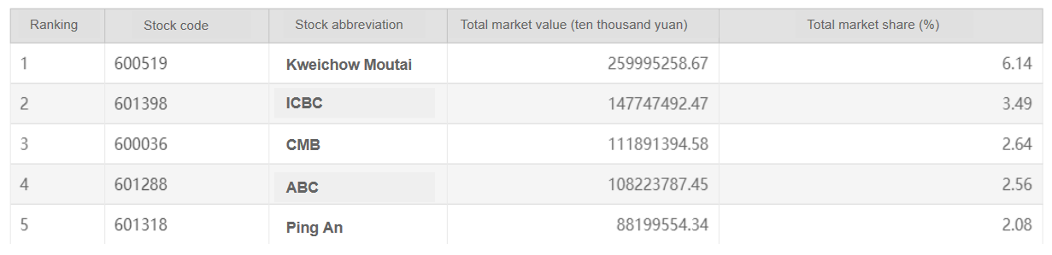
Experiments We selected top 2 stocks by market capitalization to do the experiments
We selected top 2 stocks by market capitalization to do the experiments.
We use the data up to 5 days ago to predict the price trend of the last 5 days and the buying and selling operations that should be made. The operations are based on the results of the three models predicting the ups and downs: if most models predict that the stock will rise tomorrow, and a few models predict that the stock will fall tomorrow, then we believe that the stock will rise tomorrow.

Slide 15
Experiments Take the real prices of Kweichow Moutai to show the experiment results

Slide 16
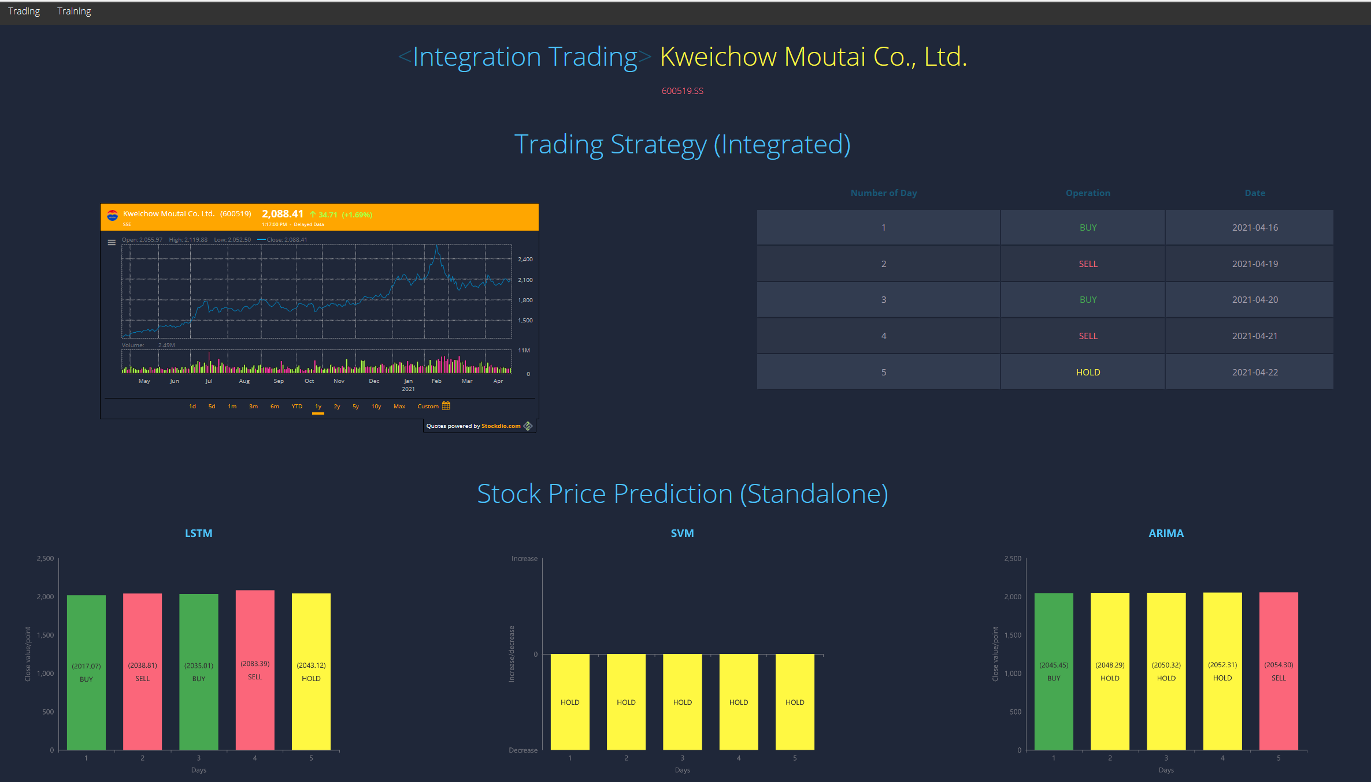
Experiments Predicted results of Kweichow Moutai

Slide 17
Experiments
Buy
Sell
Buy
Sell
Hold

Slide 18
Experiments Take the real prices of ICBC to show the experiment results

Slide 19
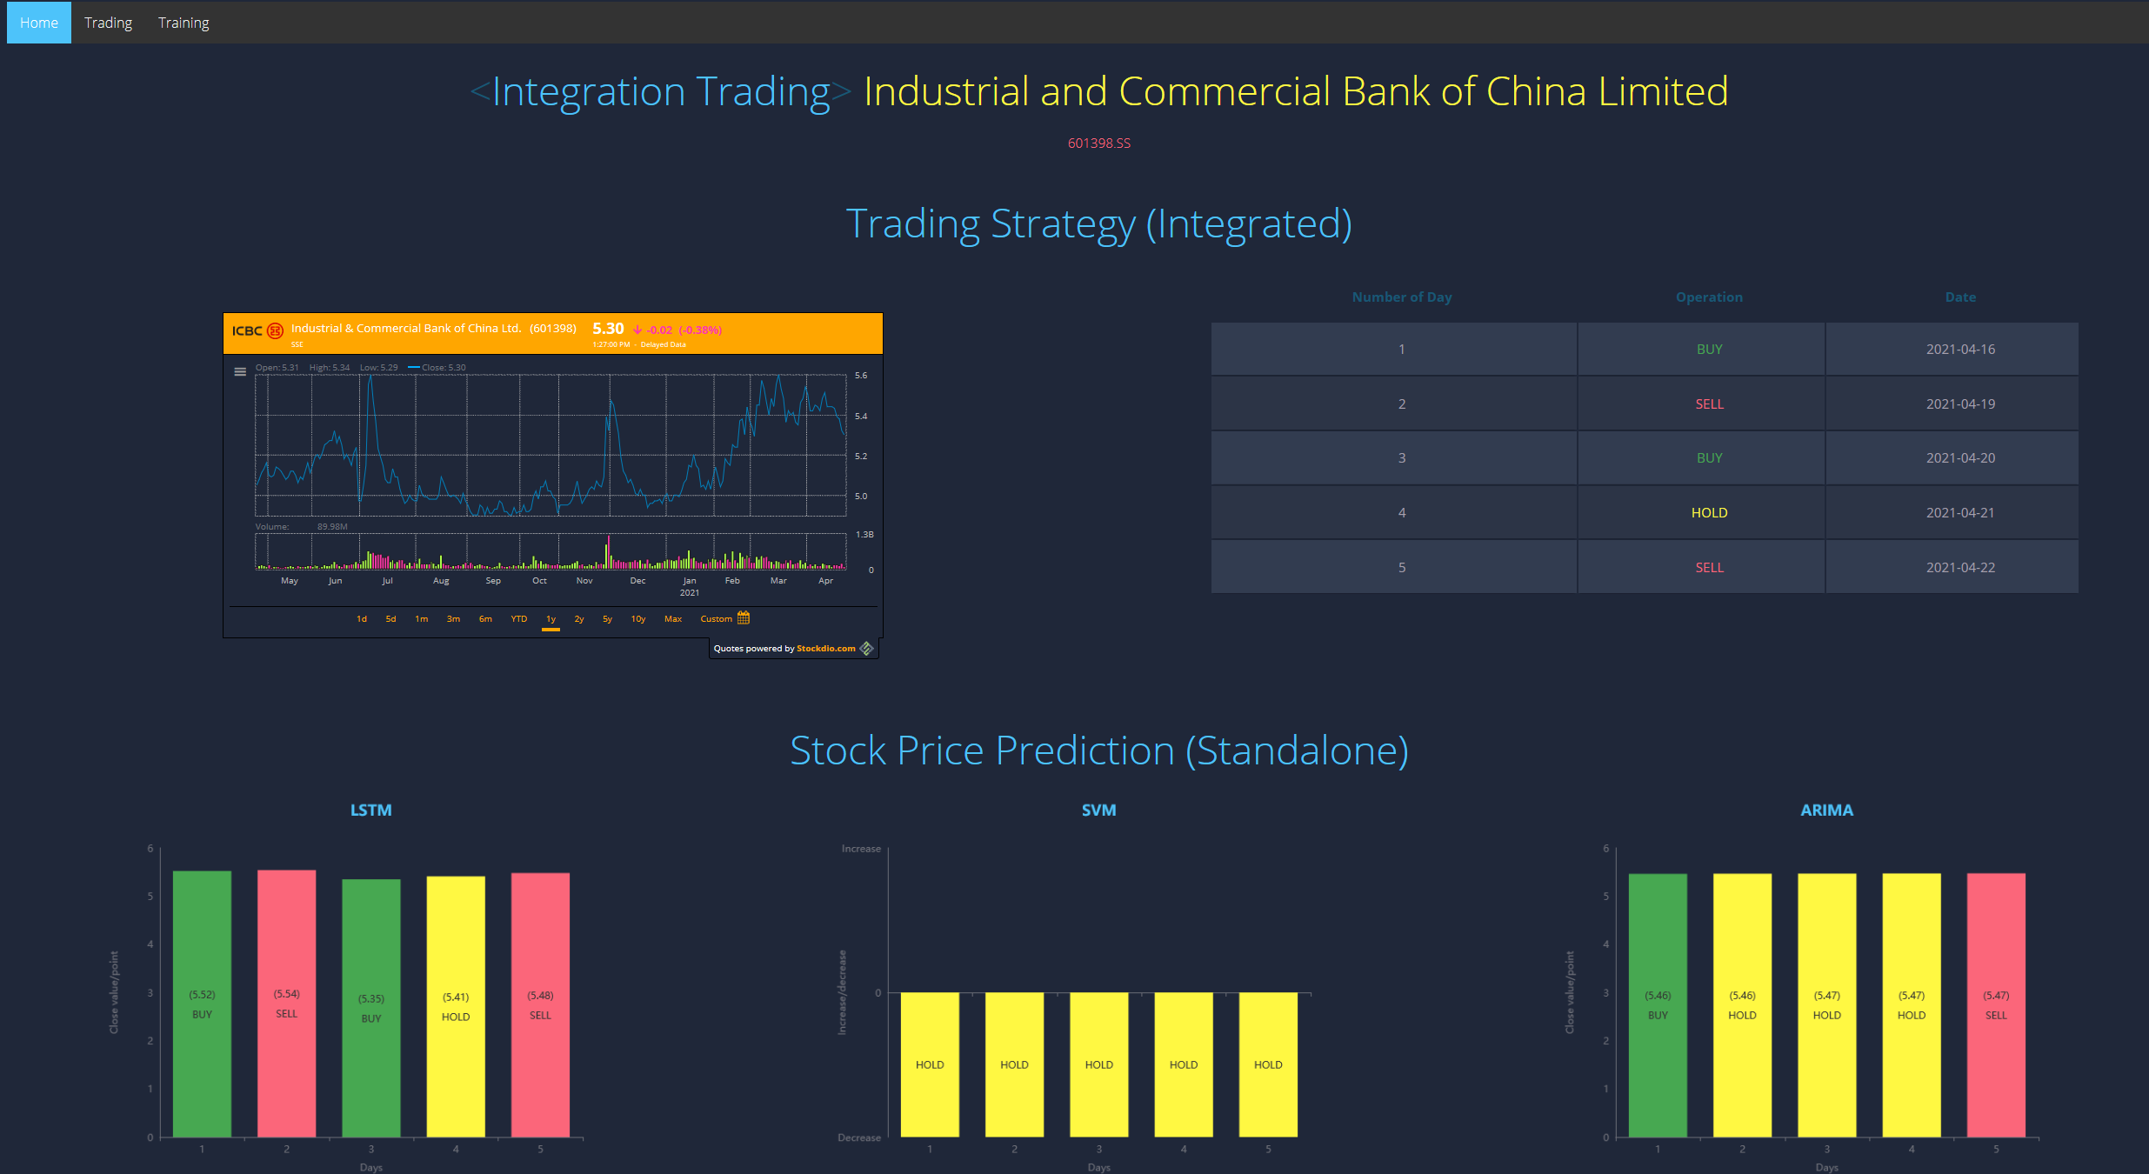
Experiments Predicted results of ICBC

Slide 20
Experiments
Buy
Sell
Buy
Hold
Sell

Slide 21
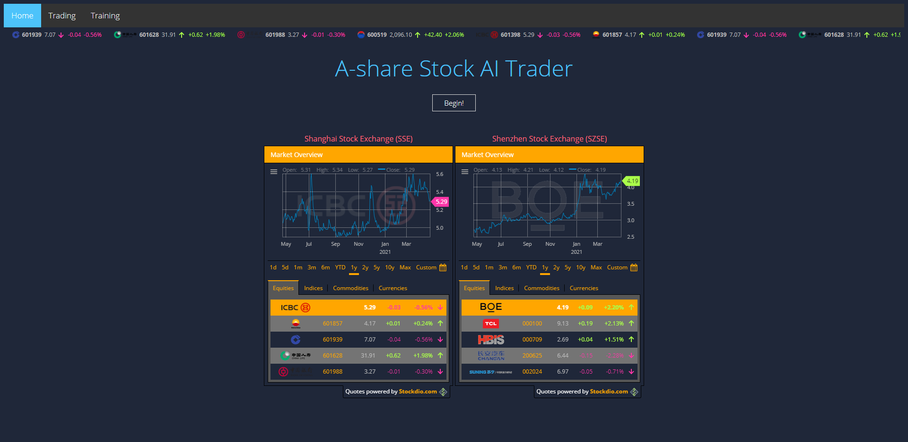
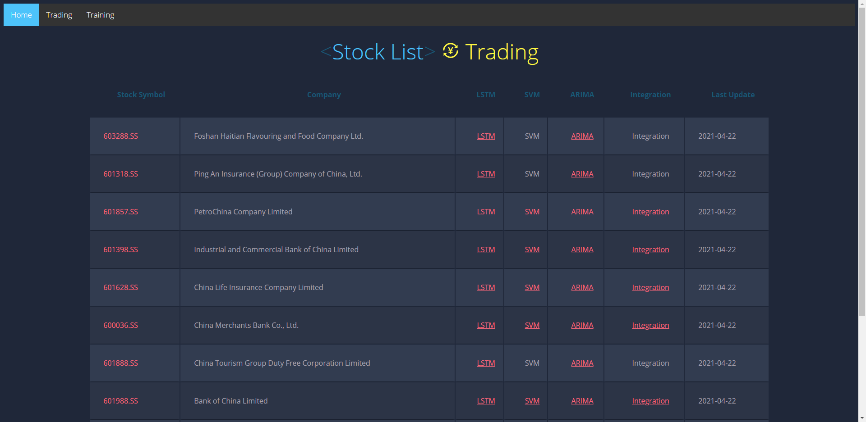
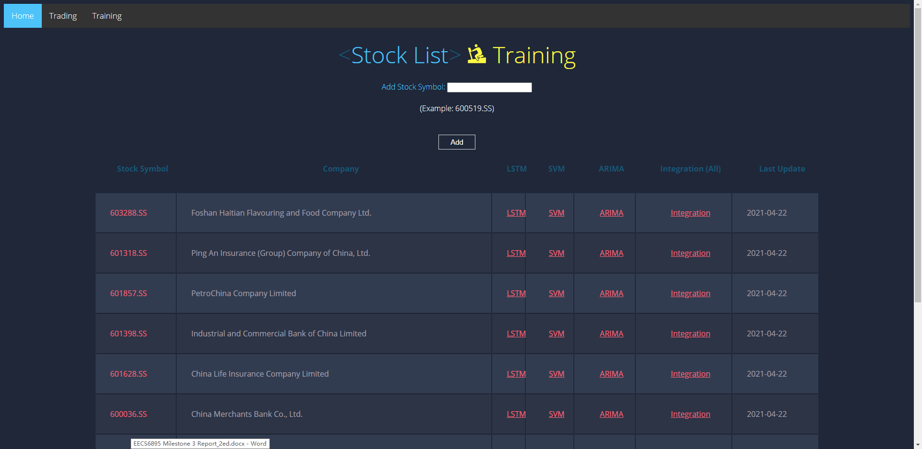
Web Application Demo http://ec2-34-207-212-22.compute-1.amazonaws.com/aitrader/

Slide 22
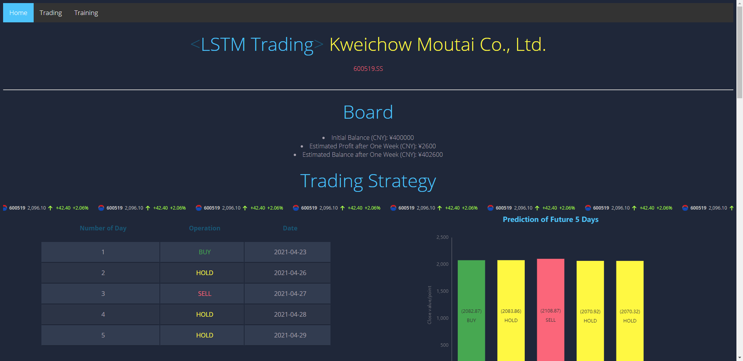
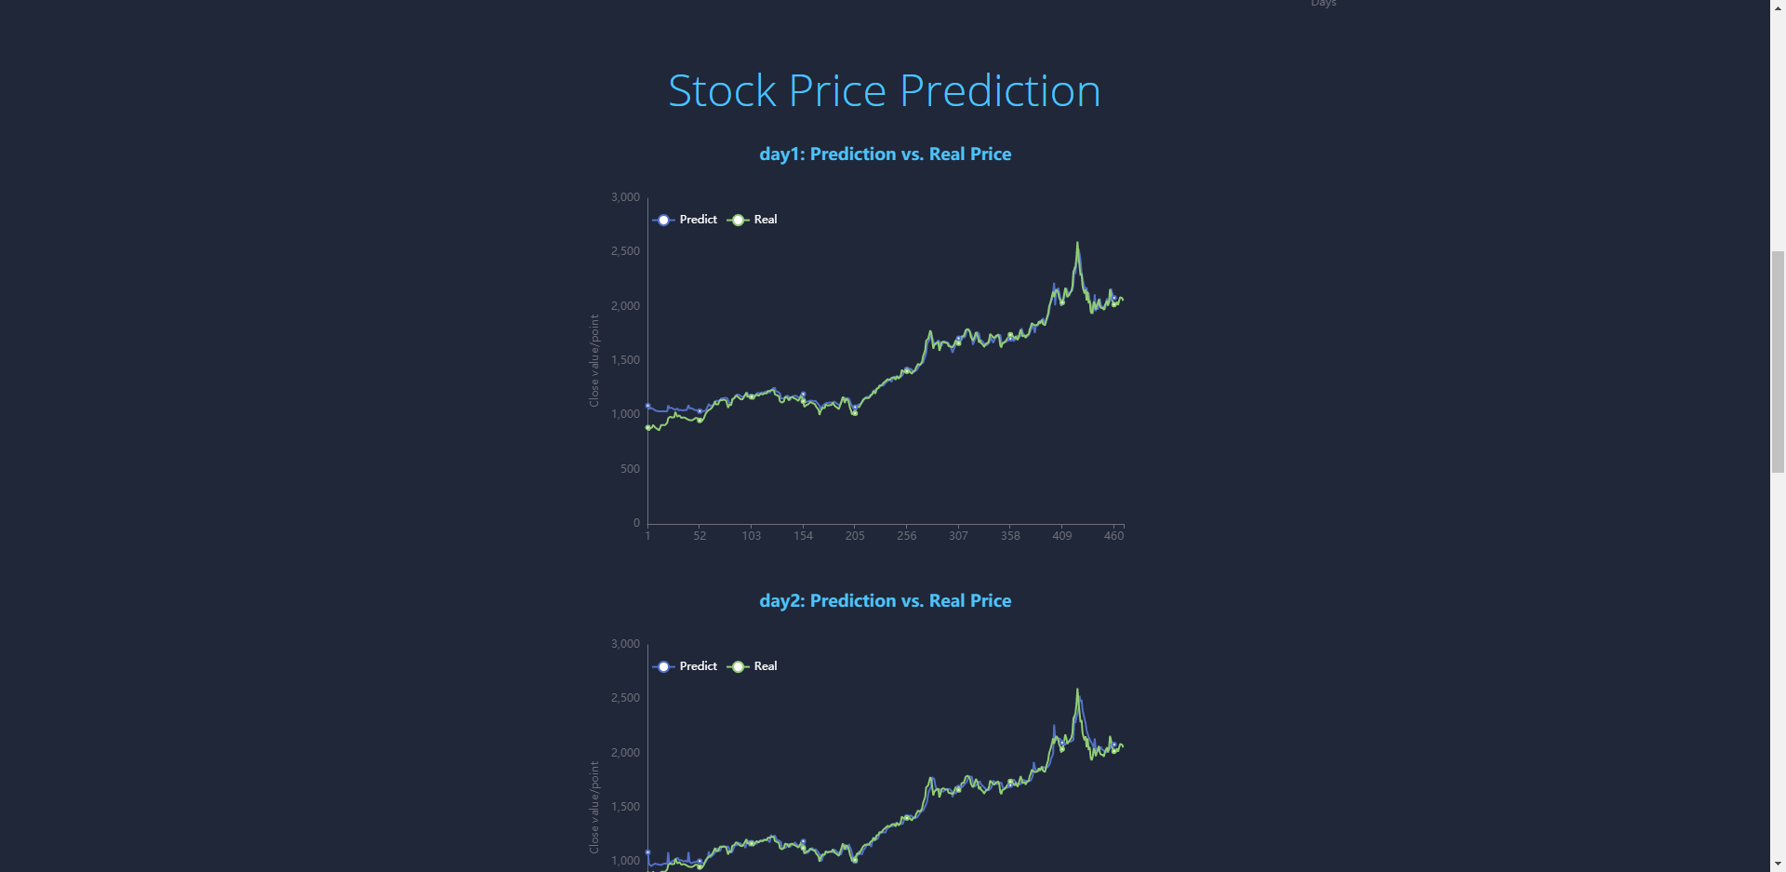
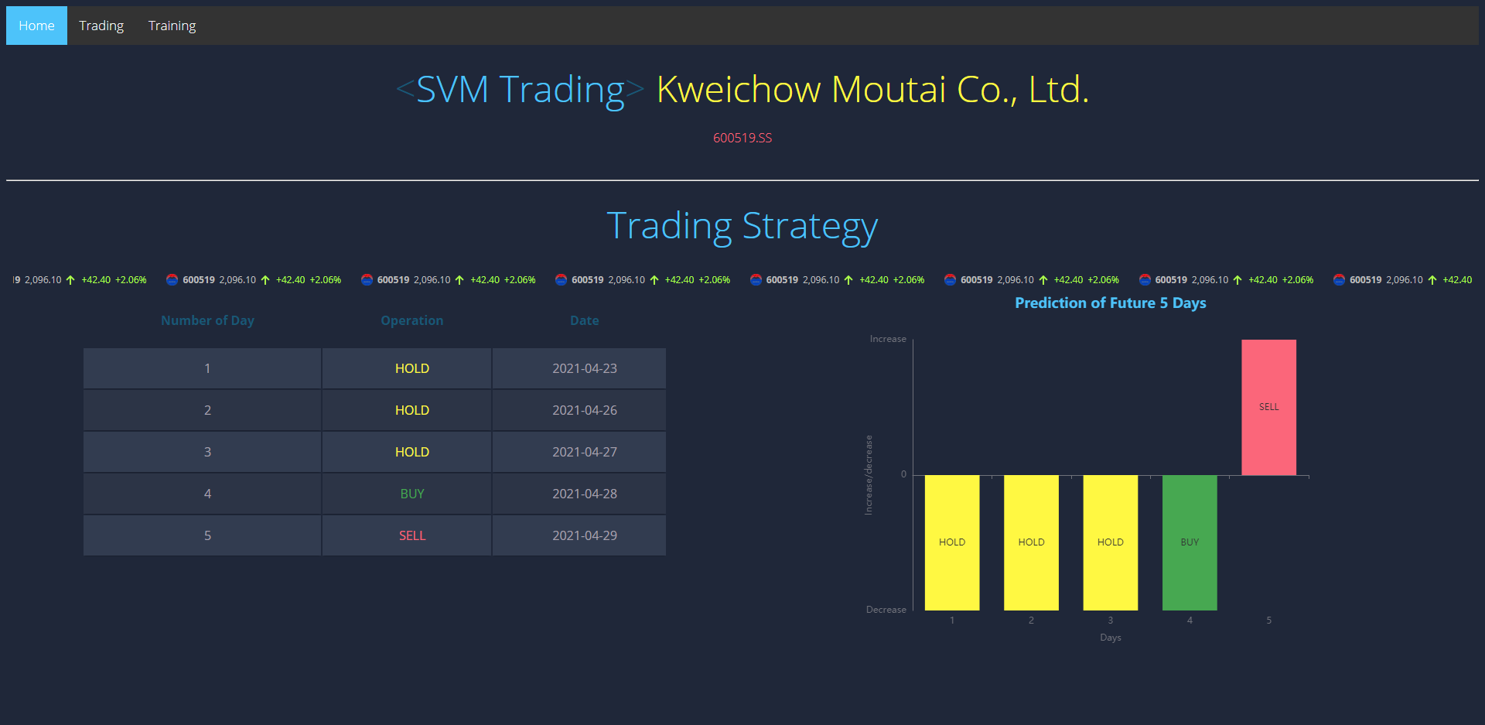
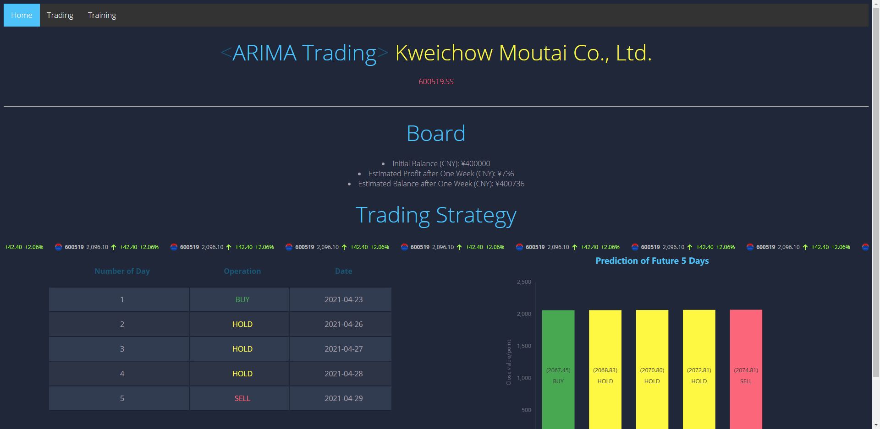
Web Application Demo http://ec2-34-207-212-22.compute-1.amazonaws.com/aitrader/

Slide 23
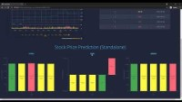
Web Application Demo http://ec2-34-207-212-22.compute-1.amazonaws.com/aitrader/
Source: https://youtu.be/Y_WyhDfFx3E

Slide 24
Challenges
Volume: 2000+ stocks, each stock has daily data points lasting since IPO.
Velocity: The training time for each stock is about 10 minutes; therefore, training a number of stocks over the night are time consuming. We use multiprocessing to run parallelly thus reducing the training time.
Variety: Preciously, either LSTM or SVM makes predictions alone, and they do not incorporate to benefit from each other. A new model ARIMA is implemented; therefore, a final predicted result is determined together by LSTM, SVM, and ARIMA.
SVM failure: The training of SVM shows that SVM may fail to be trained if all the values are 1 or -1; SVM needs y to be at least 2 values. If this situation occurs, we can increase the training sample size to solve it.
Auto update: Since stock trading data is updated every day, the data and the pre-trained models need to be updated frequently. Since we have thousands of stocks while each stock is associated with more than one model, an automatic updating script is used to do batch downloading and training tasks during a non-trading time, e.g., closing hour to opening hour.
Marvelous UI: In Milestone 3, we use default plots from Matplotlib. However, this scientific style is not attractive enough for an AI trading frontend. Therefore, a more powerful, interactive charting and visualization library called Echarts is used to replace Matplotlib to make a more attractive website.

Slide 25
Achievements
Automatic data and model update
Since the stock price is daily updated, the input training data and pre-trained models will be updated every day to ensure the most precise predicted results.
In addition to the existed LSTM and SVM models, a third model ARIMA, is developed to provide additional price prediction support.
The suggested operations (buy, sell, hold) is voted by the results from these three models instead of only one model.
The whole web application, including source data processing and model training, is deployed to AWS EC2. Therefore, everyone over the world can get access to this AI trading service.
The professional chart drawing tool, Echarts, replaces the default Matplotlib, thus showing remarkably marvelous and vivid price charts on the frontend and improving the user experience.
New model deployment
Integrated trading decisions
Deploy to the cloud platform
Vivid charts of the frontend

Slide 26
Conclusions
Business values
Take home messages
Trend prediction system of stock prices
Buy/hold/sell operating strategy for users
Integrated three machine learning algorithms for trading
Vivid visualization charts and real-time information
From the current accuracy of our three models, SVM is better than LSTM than ARIMA. However, the errors of the three models are still very high. Even if we consider the prediction results of the three models, the accuracy rate is still slightly higher than 50%.
There are many factors that affect the rise and fall of a stock. In addition to the opening price, closing price, highest price, and lowest price visible in the financial market (the 4 factors we considered in our model), there are many factors that affect its trend, such as trading volume, price-earnings ratio, market value, internal and external disks, company acquisitions, bad or good news, and a lot of human factors. These unforeseen factors all affect the trend of stocks from many parties, and it is difficult for the ML model to collect all the information in all directions and train the prediction model.

Slide 27
Timeline All milestones and final project have been finished
Milestones 1
Milestones 2
Milestones 3
Final Project
Literature survey
Methodology investigation
System design initiative
Switch from A11 Reasoning to B9 AI Trader
Data collection and procession for OHLC of 2000+ stocks via Python and yahoo_fin API
Determine the training method of the model: LSTM model for stock price forecasting
LSTM model obtained and prediction made successfully
Codes showed
Model training evaluation and tuning
Make Django web app assembled of both frontend and backend
Extend the training methods to get more models, and then make operation decisions based on the prediction results of all these models together (LSTM and SVM)
Update data and model automatically in a set period
Develop a new model, ARIMA
Make trading decisions based on the integration of three models, i.e., LSTM, SVM, and ARIMA
Deploy to the cloud platform
Focus on the frontend UI, especially the improvement of charts, ECharts

Slide 28
References
[1] Le, X.H., Ho, H.V., Lee, G. and Jung, S., 2019. Application of long short-term memory (LSTM) neural network for flood forecasting. Water, 11(7), p.1387.
[2] https://towardsdatascience.com/predicting-stock-price-with-lstm-13af86a74944
[3] Henrique, B.M., Sobreiro, V.A. and Kimura, H., 2018. Stock price prediction using support vector regression on daily and up to the minute prices. The Journal of finance and data science, 4(3), pp.183-201.
[4] https://docs.djangoproject.com/en/3.2/
[5] https://services.stockdio.com/howtouse
[6] https://blog.csdn.net/qq_40707407/article/details/81938941
[7] https://programtip.com/zh/art-524
[8] https://echarts.apache.org/en/index.html
[9] https://pypi.org/project/yahoo-fin/

Slide 29
Q & A

